Slide 1


Java ee
(ADVANCE JAVA)
Lecture-41

Slide 2
Today’s Agenda
Servlets Introduction
Servlet container
Request and response of Servlet
Advantage of Servlet over CGI.
Servlet vs Applet

Slide 3
INTRODUCTION
A “Servlet” is a server – side application which runs on the server side of a web- connection.
Just as applets dynamically extends capability functionality of a browser similarly , Servlets dynamically extends the functionality of a server.

Slide 4
SERVLET vs APPLET
APPLET with their full byte code are transmitted to the browser and are execute it within the browsers domain i.e the JVM buils into the browser handles the execution of byte code
SERVLET with their full byte code are stored inside a web server and when the Http Request arrives at the server , the server execute and response is returned back to the browser as HTML page

Slide 5
Conti.
APPLET has a well defined user interface i.e they can use java GUI technologies like awt,swings etc to generate user interface components .
SERVLETS are executes invisibly behind the screen at the server end and hence there is no issue of user interface for them.

Slide 6
Conti.
APPLET have some restrictions for security reasons for ex: applet cant connect to the database cannot access the file system it cannot generate any network connection other than server from which it has been downloaded.
SERVLET don’t have any restriction.

Slide 7
WHY SERVLET IS REQUIRED ?
To provide Dynamic Behaviour to our website
As we know , HTML can only be used to design the UI of the page i.e. it can be used to generate user interface elements of our application and accept input data.
But HTML has no way to process the data i.e. it does not know what it has to do with this data and how to generate the next repsonse.

Slide 8
WHY SERVLET IS REQUIRED ?
This is where servlets come into the picture.
Thus a servlet is a piece of java code that:
Lives on the server
Gets called by the HTML page
Fetches the data sent by the HTML page
Processes it ( i.e. communicates with the DB or any other resource)
Generates the response as an HTML file
Returns it
This is called dynamic page generation which is the
main responsibility of the servlet.

Slide 9
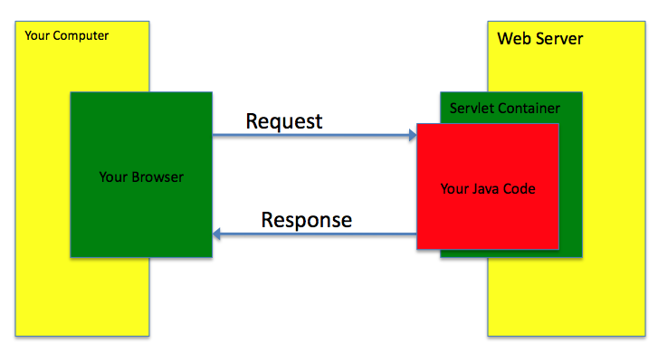
PICTORIAL REPRESENTATION

Slide 10
SERVLET CONTAINER
Servlets don’t have a main() method like a regular java program they are totally under the control of another special java code called as “Servlet Container”.
When the web server like ( apache, iis) gets request for servlets it doesn’t directly handover it to Servlet, rather this request is transferred to the Servlet Container first.

Slide 11
Conti.
It is the “Server Container” which gives request to the Servlet takes back response from it and send to the client.
A Servlet container is responsible for managing the lifecycle of servlets, mapping a URL to a particular servlet and ensuring that the URL requester has the correct access rights.

Slide 12
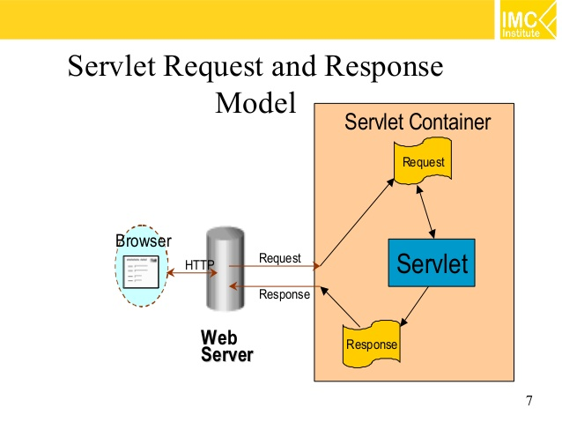
REQUEST-RESPONSE MODEL

Slide 13
STEPS REQUIRED FOR DEVELOPING A SERVLET
Inherit the required interface/classes
Override the necessary methods
Compile the code
Create the deployment descriptor
Create the appropriate directory structure under the web-server
Place the .class file
Start the web server
Open the browser and request the servlet

Slide 14
INHERITNG THE REQUIRED INTERFACE/CLASS
In order to design servlets we have to create a public class which must inherit an interface called Servlet available in the package javax.servlet.
This interface has 5 methods which are:
getServletInfo()
getServletConfig()
init()
service()
destroy()

Slide 15
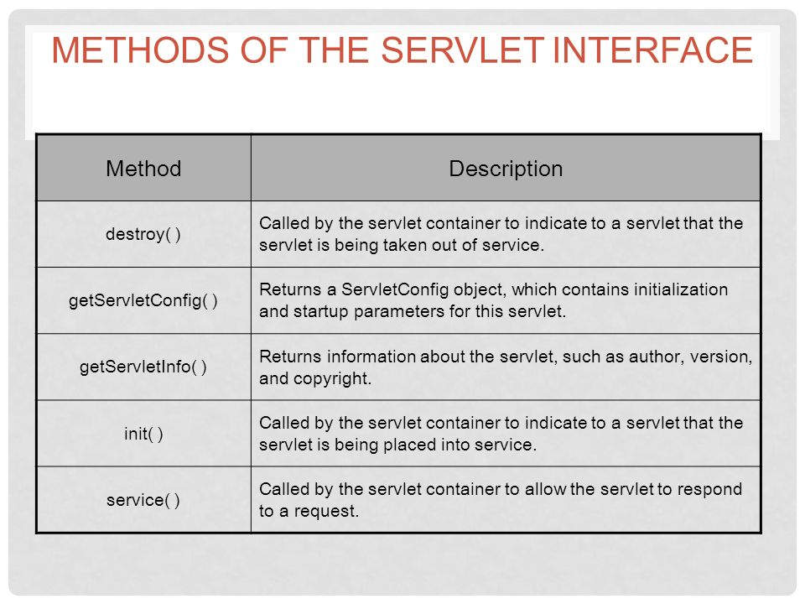
METHODS OF SERVLET

Slide 16

End Of Lecture
For any queries mail us @: scalive4u@gmail.com
Call us @ : 0755-4271659, 7879165533
Agenda for Next Lecture:
Writing the first servlet program
Deploying it in the server
Common Errors
Introduction to HTTPServlet class

